Slide 1
Normalization in DBMS

Slide 2
Normalization is the process of organizing the data in the database.
Normalization is used to minimize the redundancy from a relation or set of relations. It is also used to eliminate the undesirable characteristics like Insertion, Update and Deletion Anomalies.
Normalization divides the larger table into the smaller table and links them using relationship.
The normal form is used to reduce redundancy from the database table.

Slide 3
Why Normalisation is needed?
If a database design is not perfect, it may contain anomalies, which are like a bad dream for any database administrator. Managing a database with anomalies is next to impossible.
Update anomalies − If data items are scattered and are not linked to each other properly, then it could lead to strange situations. For example, when we try to update one data item having its copies scattered over several places, a few instances get updated properly while a few others are left with old values. Such instances leave the database in an inconsistent state.
Deletion anomalies − We tried to delete a record, but parts of it was left undeleted because of unawareness, the data is also saved somewhere else.
Insert anomalies − We tried to insert data in a record that does not exist at all.
Notes:
Normalization is a method to remove all these anomalies and bring the database to a consistent state.

Slide 4
Example of Anomalies
Sid | Sname | Cid | Cname | Fid | Fname | Salary
1 | Vinit | C1 | DBMS | F1 | Sanskriti | 60000
2 | Kaustubh | C2 | JAVA | F2 | Samreen | 50000
3 | Mihir | C1 | DBMS | F1 | Sanskriti | 60000
4 | Vanshika | C1 | DBMS | F1 | Sanskriti | 60000

Slide 5
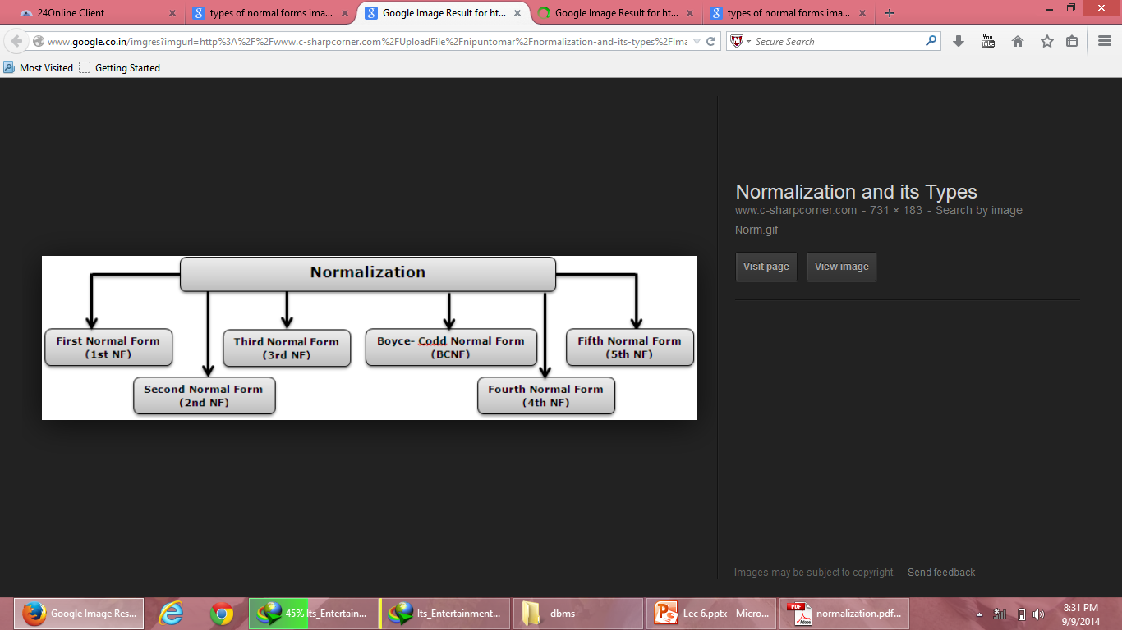
Normal Forms

Slide 6
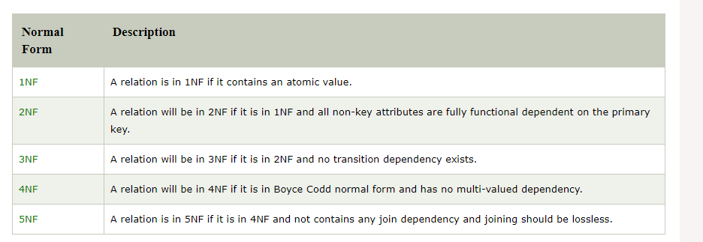

Slide 7
First Normal Form (1NF)
A relation will be 1NF if it contains an atomic value.
It states that an attribute of a table cannot hold multiple values. It must hold only single-valued attribute.
First normal form disallows the multi-valued attribute, composite attribute, and their combinations.

Slide 8
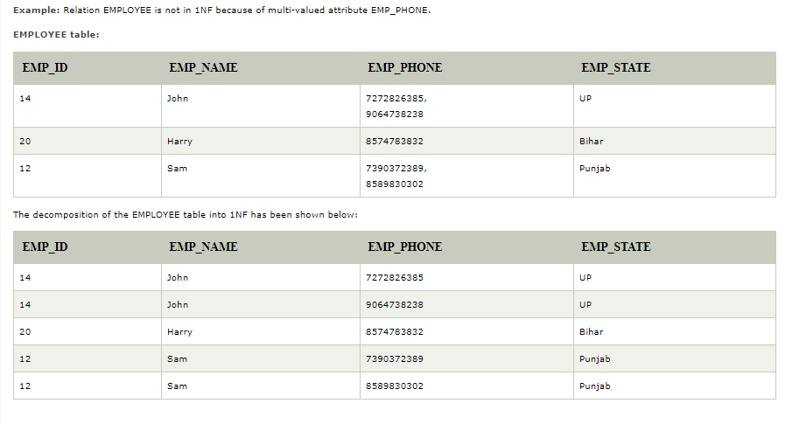

Slide 9
There should be no multi-valued attribute
Student table
This table is not in first normal form
Roll no | Name | Course
1 | Sai | c/c++
2 | Harsh | JAVA
3 | Onkar | C/DBMS

Slide 10
How to convert to first normal form
Roll No | Name | Course
1 | Sai | C
1 | Sai | C++
2 | Harsh | Java
3 | Onkar | C
3 | Onkar | DBMS
Primary key= Roll No + Course ---- Composite Key

Slide 11
Second solution
Roll No | Name | Course1 | Course2
1 | Sai | C | C++
2 | Harsh | Java | NULL
3 | Onkar | C | DBMS
Primary Key: Roll No

Slide 12
Third Solution
Divide the tables into number of tables
Roll No(Primary Key) | Name
1 | Sai
2 | Harsh
3 | Onkar
Roll No(Foreign Key) | Course
1 | C
1 | C++
2 | JAVA
3 | C
3 | DBMS

Slide 13

Example: Unnormalized table
Course Code | Course Name | Teacher Name | Roll No | Name | System Used | Hourly Rate | Total Hours
C1 | Visual Basic | ABC | 100 | A1 | P – I | 20 | 7
 |  |  | 101 | A2 | P – II | 30 | 3
 |  |  | 102 | A3 | Celeron | 10 | 6
 |  |  | 103 | A4 | P – IV | 40 | 1
C2 | Oracle & Dev | DEF | 100 | A1 | P – I | 20 | 7
 |  |  | 104 | A5 | P – III | 35 | 3
 |  |  | 105 | A6 | P – II | 30 | 1
 |  |  | 101 | A2 | P – II | 30 | 2
C3 | C++ | KJP | 106 | A7 | P – IV | 40 | 3
 |  |  | 107 | A8 | P – IV | 40 | 2
 |  |  | 108 | A9 | P – I | 20 | 1
C4 | Java | Kumar | 109 | A10 | Cyrix | 20 | 2

Slide 14
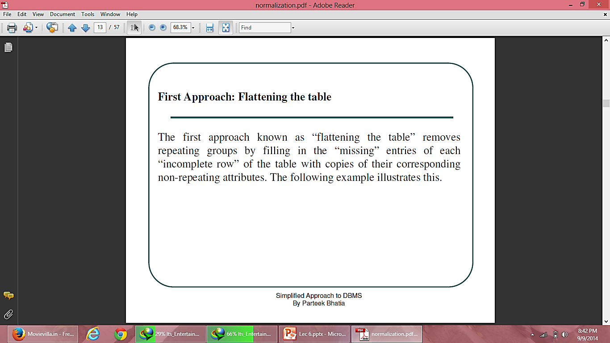
Approaches to normalize table
In general, there are two basic approaches to normalize tables.

Slide 15
STUDENT (Flattening)
(Normalized Table)
Course Code | Course Name | Teacher Name | Roll No | Name | System Used | Hourly Rate | Total Hours
C1 | Visual Basic | ABC | 100 | A1 | P – I | 20 | 7
C1 | Visual Basic | ABC | 101 | A2 | P – II | 30 | 3
C1 | Visual Basic | ABC | 102 | A3 | Celeron | 10 | 6
C1 | Visual Basic | ABC | 103 | A4 | P – IV | 40 | 1
C2 | Oracle & Dev | DEF | 100 | A1 | P – I | 20 | 7
C2 | Oracle & Dev | DEF | 104 | A5 | P – III | 35 | 3
C2 | Oracle & Dev | DEF | 105 | A6 | P – II | 30 | 1
C2 | Oracle & Dev | DEF | 101 | A2 | P – II | 30 | 2
C3 | C++ | KJP | 106 | A7 | P – IV | 40 | 3
C3 | C++ | KJP | 107 | A8 | P – IV | 40 | 2
C3 | C++ | KJP | 108 | A9 | P – I | 20 | 1
C4 | Java | Kumar | 109 | A10 | Cyrix | 20 | 2

Slide 16
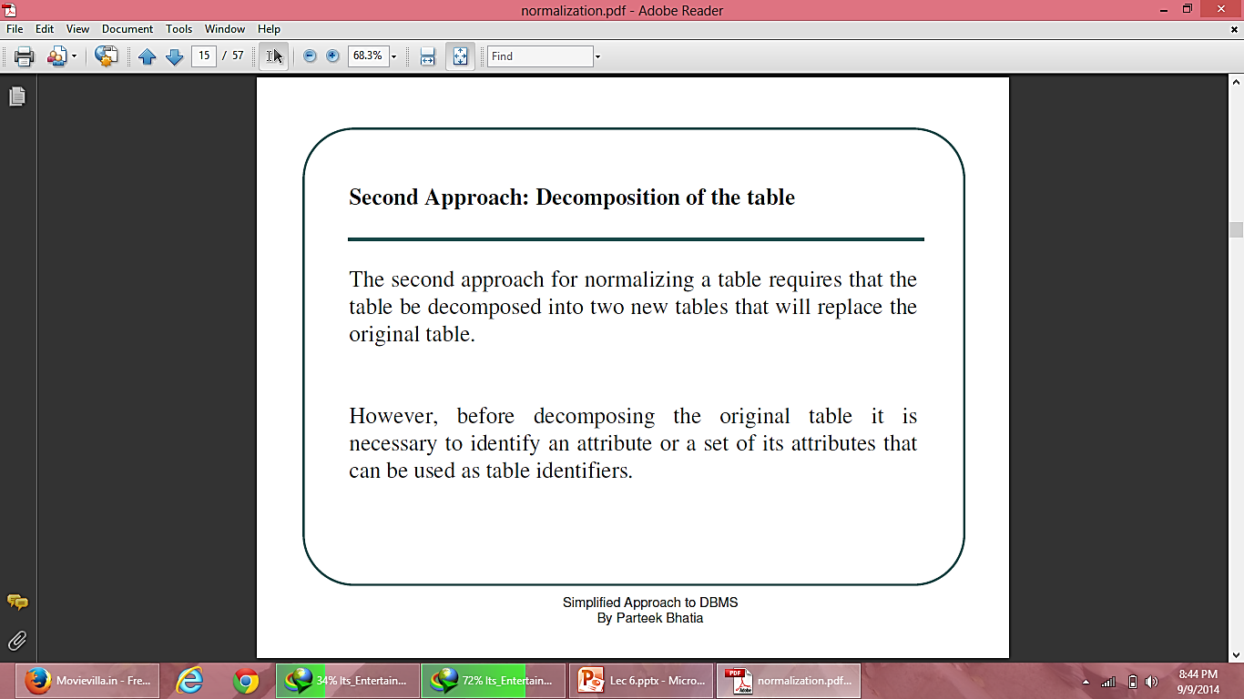
Approaches to normalize table

Slide 17
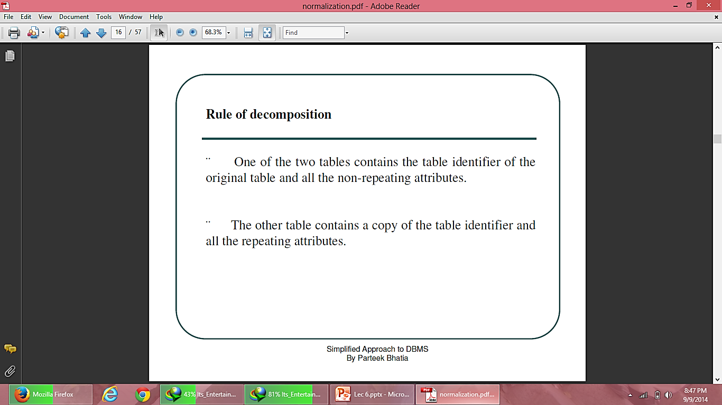

Slide 18
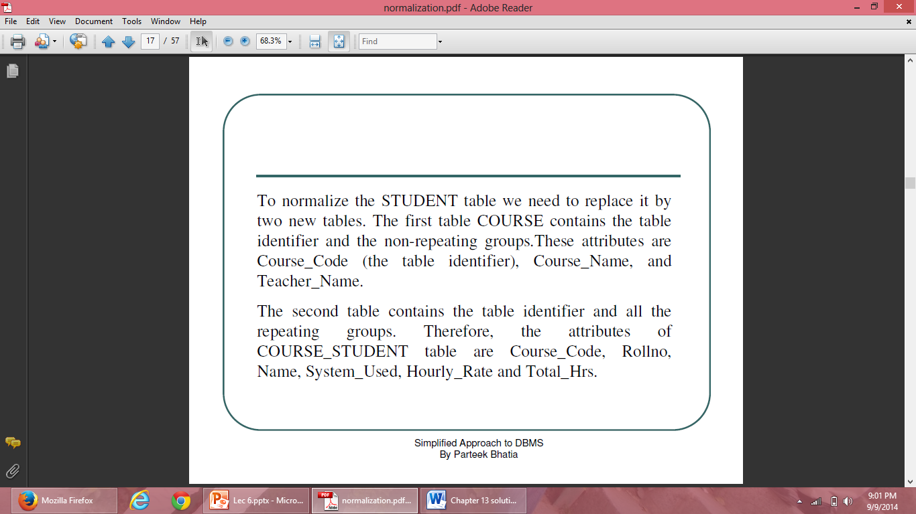

Slide 19
STUDENT (Decomposition)
(Normalized Table)
COURSE
Course Code | Roll No | Name | System Used | Hourly Rate | Total Hours
C1 | 100 | A1 | P – I | 20 | 7
C1 | 101 | A2 | P – II | 30 | 3
C1 | 102 | A3 | Celeron | 10 | 6
C1 | 103 | A4 | P – IV | 40 | 1
C2 | 100 | A1 | P – I | 20 | 7
C2 | 104 | A5 | P – III | 35 | 3
C2 | 105 | A6 | P – II | 30 | 1
C2 | 101 | A2 | P – II | 30 | 2
C3 | 106 | A7 | P – IV | 40 | 3
C3 | 107 | A8 | P – IV | 40 | 2
C3 | 108 | A9 | P – I | 20 | 1
C4 | 109 | A10 | Cyrix | 20 | 2
Course Code | Course Name | Teacher Name
C1 | Visual Basic | ABC
C2 | Oracle & Dev | DEF
C3 | C++ | KJP
C4 | Java | Kumar
COURSE_STUDENT
PK = (Course_code, RollNo)

Slide 20
Functional Dependency
Method to describe relationship between attributes
Like X -> Y --- X determines Y or Y is determined by X
X- Determinant
Y- Dependent
Example: Sid -> Sname
Like I have Sname – Alok,Alok
How will I distinguish?

Slide 21
Trivial FD: X-> Y then Y is subset of X
Example : Sid -> Sid
These are always true, as attribute to be determined is subset.
Another example: Sid Sname -> Sid. Its intersection cannot be NULL

Slide 22
Non trivial dependency
X-> Y X intersection Y = null
Sid -> sname
Sid -> semester
Sid -> Phone
Intersection of all these is always NULL

Slide 23
Trivial functional dependency
A → B has trivial functional dependency if B is a subset of A.
The following dependencies are also trivial like: A → A, B → B
Example:
Consider a table with two columns Employee_Id and Employee_Name.
{Employee_id, Employee_Name} → Employee_Id is a trivial functional dependency as
Employee_Id is a subset of {Employee_Id, Employee_Name}.
Also, Employee_Id → Employee_Id and Employee_Name → Employee_Name are trivial dependencies too.

Slide 24
Non-trivial functional dependency
A → B has a non-trivial functional dependency if B is not a subset of A.
When A intersection B is NULL, then A → B is called as complete non-trivial.
Example:
ID → Name,
Name → DOB

Slide 25
Example
Employee
SSN | Name | JobType | DeptName
557-78-6587 | Lance Smith | Accountant | Salary
214-45-2398 | Lance Smith | Engineer | Product
Note: Name is functionally dependent on SSN because an employee’s name can be uniquely determined from their SSN. Name does not determine SSN, because more than one employee can have the same name..

Slide 26
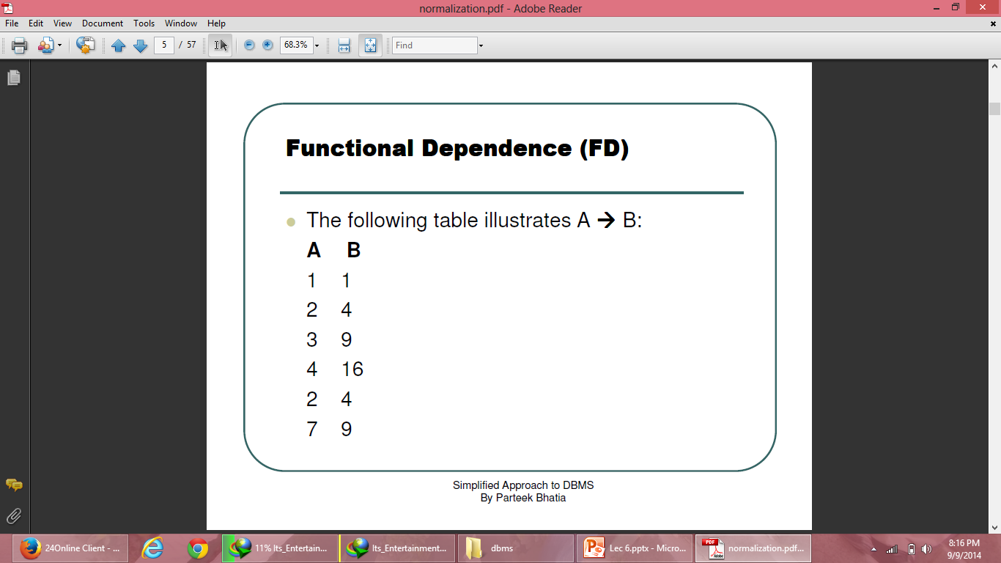
Functional Dependence (FD)

Slide 27
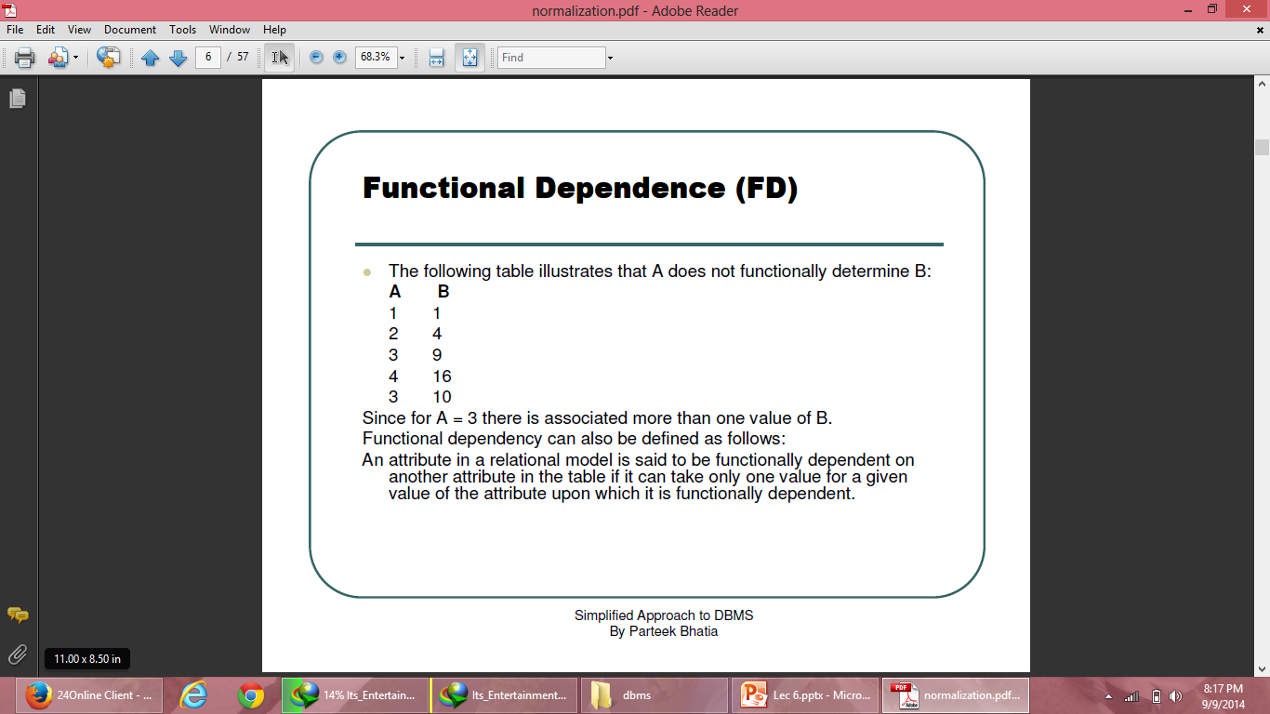
Functional Dependence (FD)

Slide 28
Fully Functional Dependency
Fully Functional Dependence(FFD) is defined as attribute Y is FFD on attribute X, if it is a FD on X and not FD on any proper subset of X.
(X1,X2)->Y
X
It should dependent on combination.

Slide 29
Closure method: Method to find all candidate keys in a table
R(ABCD)
FD{A->B,B->C,C->D}
A⁺ -> ABCD
B⁺ -> BCD
C⁺ -> CD
D⁺ -> D So, candidate key (A)
Transitive Property

Slide 30
AB⁺ -> ABCD
A candidate key, but AB cannot be
So, A is only candidate key.
If you have B with it then it is superkey(B).
Prime attribute: A
Non Prime attribute: B,C,D

Slide 31
Solve the following question:
Function dependency given as below for relation R(ABCD)
A->B
B->C
C->D
D->A
which of the following is/are the candidate keys?
A ONLY
B ONLY
C ONLY
D ONLY
ALL OF THE ABOVE
Notes:
A+=ABCD
B+=BCDA
C+=CDAB
D+=DABC
ANS –E)

Slide 32
Solution
R(ABCD)
FD ={A->B,B->C,C->D,D->A}
A⁺ -> {ABCD}
B⁺ -> {BCDA}
C⁺ -> {CDAB}
D⁺ -> {ABCD}
Candidate Key{A,B,C,D}
Prime Attributes: attributes that help in making primary key .So, {A,B,C,D} are all prime attributes

Slide 33
Consider the following functional dependencies
^{AB -> C}
^{C -> D}
BD -> E for a relation R(A,B,C,D,E).
^{Closure of AB={ A,B,C,D,E}}
^{CLOSURE OF C={C,D}}
^{CLOSURE OF BD={B,D,E}}
Find closure of ACD, BCD, AB, CD.
Notes:
ACD= ACD
BCD=BCDE
AB= ABCDE
CD=CD

Slide 34
Ques 1. Consider the following functional dependencies
{AB->C, B->D, C->E, D->A} for a relation R(A,B,C,D,E).
^{Find closure of B, CD, BC}
Ques 2. Given R(E-ID, E-NAME, E-CITY, E-STATE)
FDs = { E-ID->E-NAME, E-ID->E-CITY, E-ID->E-STATE, E-CITY->E-STATE }
Finding Candidate Keys and Super Keys of a Relation using FD set

Slide 35
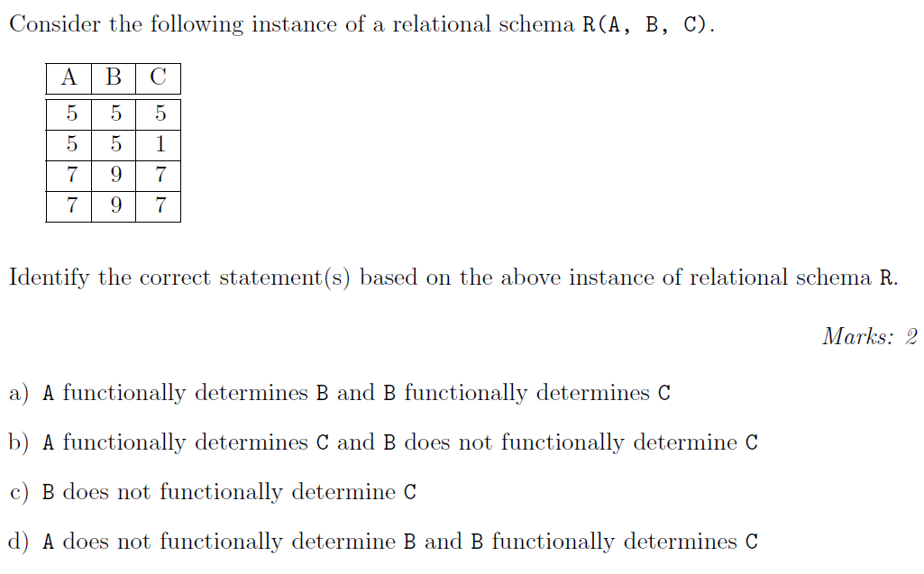
Notes:
Answer: c)
Explanation: A ! B holds true for the above instance. We can be sure that B does not
functionally determine C because for the value 5 of B, it gives two dierent values of C i.e.
5 and 1. From the above instance it is concluded that A does not functionally determine C
because for A = 5 there are two values of C.

Slide 36
Function dependency given as below for relation R(ABCD)
FD: {A->B, B->C, C->D}
In the above case, choose the prime attributes?
A
B
A,B,C,D
C
Notes:
CK={A}
PRIME ATTRIBUTES=A
NPA= B,C,D

Slide 37
Shortcut for identify Candidate Key
Consider a relation R(ABCDE)
FD={A->B,BC->D, E->C, D->A}
Step 1: Check the attributes on the right side which are getting determined i.e. BCDA. E can’t be determined so, E will be used in candidate key
Step 2: E should be found which is {EC}
Step3 : Find combination with E starting from A
AE ⁺ =ABECD
And so on with other BE ⁺,CE ⁺,DE ⁺
Find which others are candidate key?
a) BE b) CE c) DE d) BE and DE

Slide 38
Inference Rule (IR)
The Armstrong's axioms are the basic inference rule.
Armstrong's axioms are used to conclude functional dependencies on a relational database.
The inference rule is a type of assertion. It can apply to a set of FD(functional dependency) to derive other FD.
Using the inference rule, we can derive additional functional dependency from the initial set.
The Functional dependency has 6 types of inference rule:

Slide 39
Reflexive Rule (IR₁)
In the reflexive rule, if Y is a subset of X, then X determines Y.
If X ⊇ Y then X → Y
Any attribute determining itself
Example:
X = {a, b, c, d, e}
Y = {a, b, c}

Slide 40
Augmentation Rule (IR₂)
The augmentation is also called as a partial dependency. In augmentation, if X determines Y, then XZ determines YZ for any Z.
If X → Y then XZ → YZ
Example:
For R(ABCD), if A → B then AC → BC
Example
Sid -> sname
Sid Phoneno -> Sname Phoneno

Slide 41
Transitive Rule (IR₃)
In the transitive rule, if X determines Y and Y determine Z, then X must also determine Z.
If X → Y and Y → Z then X → Z

Slide 42
Union Rule (IR₄)
Union rule says, if X determines Y and X determines Z, then X must also determine Y and Z.
If X → Y and X → Z then X → YZ
Proof:
1. X → Y (given)
2. X → Z (given)
3. X → XY (using IR₂ on 1 by augmentation with X. Where XX = X)
4. XY → YZ (using IR₂ on 2 by augmentation with Y)
5. X → YZ (using IR₃ on 3 and 4)

Slide 43
Decomposition Rule (IR₅)
Decomposition rule is also known as project rule. It is the reverse of union rule.
This Rule says, if X determines Y and Z, then X determines Y and X determines Z separately.
If X → YZ then X → Y and X → Z
Proof:
1. X → YZ (given)
2. YZ → Y (using IR₁ Rule)
3. X → Y (using IR₃ on 1 and 2)

Slide 44
Pseudo transitive Rule (IR₆)
In Pseudo transitive Rule, if X determines Y and YZ determines W, then XZ determines W.
If X → Y and YZ → W then XZ → W
Proof:
1. X → Y (given)
2. WY → Z (given)
3. WX → WY (using IR₂ on 1 by augmenting with W)
4. WX → Z (using IR₃ on 3 and 2)

Slide 45
Second Normal Form
Table must be in first normal form
There should be no partial dependency
All non prime attributes should be fully dependent on candidate key
Non prime attributes: Attributes that are not participating in formation of candidate key

Slide 46
Second Normal Form (2NF)
A relation R is in 2NF if and only if it is in 1NF and every non-key attribute is fully functional dependent on the primary key.
Name
RollNo
System_Used
Functional Dependence Diagram
Course_Code
Hourly_Rate
Course_Name
Total Hrs.
Teacher_Name

Slide 47
Second Normal Form (2NF)
A resultant database of 1NF Course_Code does not satisfy above rule, because non-key attributes Name, System_Used and Hourly_Rate are not fully dependent on the primary key (Course_Code, Rollno) because Name, System_Used and Hourly_Rate are functional dependent on Rollno and Rollno is a subset of the primary key so it does not hold the law of fully functional dependence.

Slide 48
Rule to convert 1NF to 2NF
Consider a relation where a primary key consists of attributes A and B. These two attributes determine all other attributes.
Attribute C is fully dependent on the key.
Attribute D is partially dependent on the key because we only need attribute A to functionally determine it.
Attributes C and D are non-key attributes.

Slide 49
Rule to convert 1NF to 2NF
The rule is to replace the original relation by two new relations. The first new relation has three attributes: A, B and C. The primary key of this relation is (A, B) i.e. the primary key of the original relation. The second relation has A and D as its only two attributes. Observe that attribute A has been designated, as the primary key of the second relation and that attribute D is now fully dependent on the key.

Slide 50
Second Normal Form (2NF)
HOURS_ASSIGNED
STUDENT_SYSTEM_CHARGE
Course Code | Roll No | Total Hours
C1 | 100 | 7
C1 | 101 | 3
C1 | 102 | 6
C1 | 103 | 1
C2 | 100 | 7
C2 | 104 | 3
C2 | 105 | 1
C2 | 101 | 2
C3 | 106 | 3
C3 | 107 | 2
C3 | 108 | 1
C4 | 109 | 2
Roll No | Name | System Used | Hourly Rate
100 | A1 | P – I | 20
101 | A2 | P – II | 30
102 | A3 | Celeron | 10
103 | A4 | P – IV | 40
100 | A1 | P – I | 20
104 | A5 | P – III | 35
105 | A6 | P – II | 30
101 | A2 | P – II | 30
106 | A7 | P – IV | 40
107 | A8 | P – IV | 40
108 | A9 | P – I | 20
109 | A10 | Cyrix | 20
COURSE
Course Code | Course Name | Teacher Name
C1 | Visual Basic | ABC
C2 | Oracle & Dev | DEF
C3 | C++ | KJP
C4 | Java | Kumar

Slide 51
Second Normal Form
Customer ID | Store ID | Location
1 | 1 | Delhi
1 | 3 | Mumbai
2 | 1 | Delhi
3 | 2 | Banglore
4 | 3 | Mumbai
Prime attribute: CustomerID,StoreID
Non Prime Attribute: Location
Location is determined by store id

Slide 52
Convert to second normal form
Divide the table
Customer id | StoreID
1 | 1
1 | 3
2 | 1
3 | 2
4 | 3
Store id | location
1 | Delhi
2 | Banglore
3 | mumbai

Slide 53
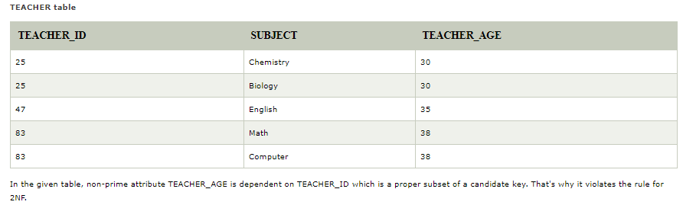
Second Normal Form (2NF)
Example: Let's assume, a school can store the data of teachers and the subjects they teach. In a school, a teacher can teach more than one subject.

Slide 54
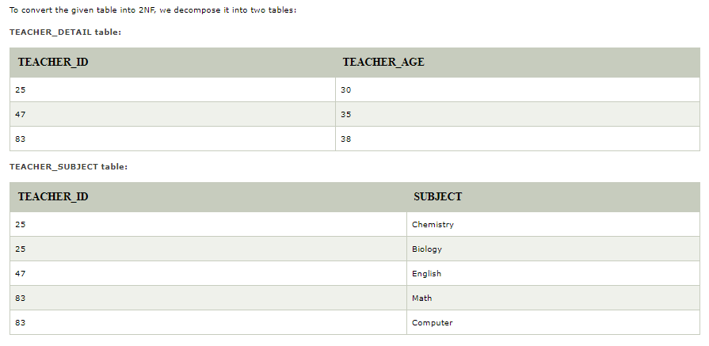

Slide 55
Question
A relation R(ABCDEF) where Function dependencies are given below:
C->F, E->A, EC->D,A->B
Find Candidate Key
a) EC b) FC c)Both
ii. Find Prime Attribute
E,C b) C,E,A c) BOTH
iii. Find Non Prime attributes
a)A,B,D,E B) A,B,D,F c) NONE
Notes:
FADB CAN BE DETERMINED AS THEY ARE ON RIGHT SIDE
SO EC CAN’T BE DETERMINED SO IT HAS TO BE IN CANDIDATE KEY
FIND CLOSURE OF EC: ECADBF
SO ONLY ONE CANDIDATE KEY EC
Prime attributes are E,C
To check 2nd normal form, LHS from FD should be proper subset of CK and RHS should be a non-prime attribute then it is partial dependency
So in this example check first LHS
C is proper subset of candidate key and RHS F is a non prime attribute
Similarly check for 2nd one, E is proper subset and RHS A is a non prime attribute so it is again partial dependency
A proper subset of a set A is a subset of A that is not equal to A. In other words, if B is a proper subset of A, then all elements of B are in A but A contains at least one element that is not in B. For example, if A={1,3,5} then B={1,5} is a proper subset of A.

Slide 56
Question
Consider following functional dependencies in relation R (A, B, C, D )
AB -> C
BC -> D
Determine whether the relation is in Second Normal Form or not?
Notes:
In the above relation, AB is the only candidate key and there is no partial dependency, i.e., any proper subset of AB doesn’t determine any non-prime attribute.

Slide 57
Prime and nonprime attributes
An attribute of a relation schema R is called Prime attribute if it is a member of some candidate key of R.
An attribute is called non prime if it is not a prime attribute i.e. it is not the member of any candidate key.

Slide 58
Third Normal Form (3NF)
A relation R is in 3NF if and only if the following conditions are satisfied simultaneously:
  R is already in 2NF
  No nonprime attribute functionally determines any other nonprime attribute Or No nonprime attribute is transitively dependent on the key
The objective of transforming relations into 3NF is to remove all transitive dependencies.

Slide 59
Third Normal Form (3NF)
Functional Dependence Diagram
Name
RollNo
System_Used
RollNo → System_Used
System_Used → Hourly_Rate
It Means RollNo → Hourly_Rate
Hourly_Rate

Slide 60
Third Normal Form (3NF)
STUDENT_SYSTEM_CHARGE
STUDENT_SYSTEM
Roll No | Name | System Used | Hourly Rate
100 | A1 | P – I | 20
101 | A2 | P – II | 30
102 | A3 | Celeron | 10
103 | A4 | P – IV | 40
100 | A1 | P – I | 20
104 | A5 | P – III | 35
105 | A6 | P – II | 30
101 | A2 | P – II | 30
106 | A7 | P – IV | 40
107 | A8 | P – IV | 40
108 | A9 | P – I | 20
109 | A10 | Cyrix | 20
Roll No | Name | System Used
100 | A1 | P – I
101 | A2 | P – II
102 | A3 | Celeron
103 | A4 | P – IV
100 | A1 | P – I
104 | A5 | P – III
105 | A6 | P – II
101 | A2 | P – II
106 | A7 | P – IV
107 | A8 | P – IV
108 | A9 | P – I
109 | A10 | Cyrix
CHARGES
System Used | Hourly Rate
Celeron | 10
Cyrix | 20
P – I | 20
P – II | 30
P – III | 35
P – IV | 40
Convert To
2NF
3NF

Slide 61
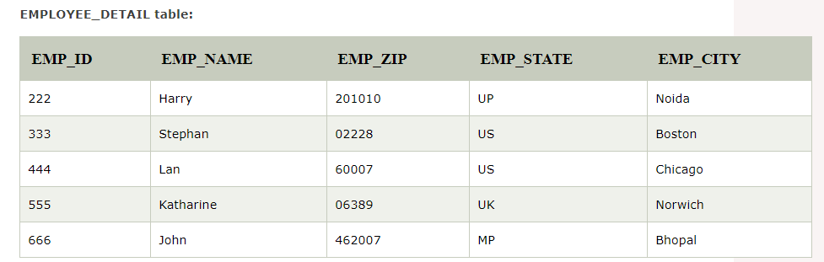

Slide 62
Super key in the table above:
{EMP_ID}, {EMP_ID, EMP_NAME}, {EMP_ID, EMP_NAME, EMP_ZIP}....so on
Candidate key: {EMP_ID}
Non-prime attributes: In the given table, all attributes except EMP_ID are non-prime.
Here, EMP_STATE & EMP_CITY dependent on EMP_ZIP and EMP_ZIP dependent on EMP_ID. The non-prime attributes (EMP_STATE, EMP_CITY) transitively dependent on super key(EMP_ID). It violates the rule of third normal form.
That's why we need to move the EMP_CITY and EMP_STATE to the new <EMPLOYEE_ZIP> table, with EMP_ZIP as a Primary key.

Slide 63
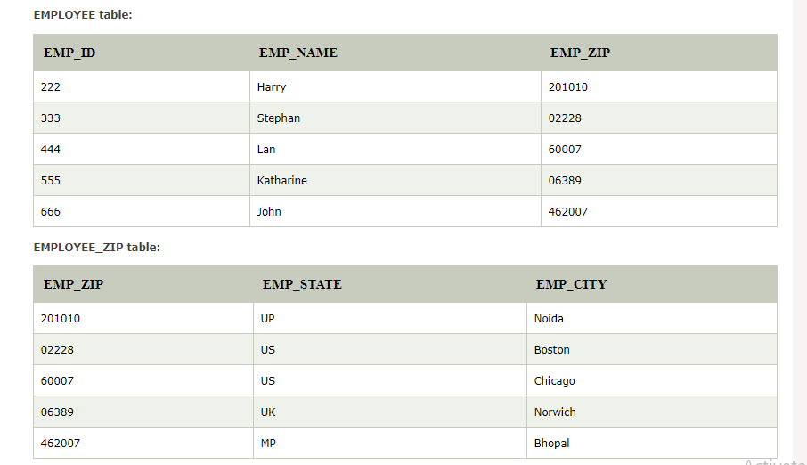

Slide 64
Question
A relation R(ABCD) where Function dependencies are given below:
AB->C, C->D
Candidate Key- AB
Prime Attributes- A,B
Non- Prime Attributes- C,D
Is the relation in 3NF?

Slide 65
Question
A relation R(ABCD) where Function dependencies are given below:
AB->CD, D->A
Is the relation in 3NF?
Notes:
Candidate Key- {AB,DB}
Prime Attributes- A,B,D
Non- Prime Attributes- C

Slide 66
Boyce Codd normal form (BCNF)
BCNF is the advance version of 3NF. It is stricter than 3NF.
A table is in BCNF if every functional dependency X → Y, X is the super key of the table.
For BCNF, the table should be in 3NF, and for every FD, LHS is super key.
Example: Let's assume there is a company where employees work in more than one department.

Slide 67
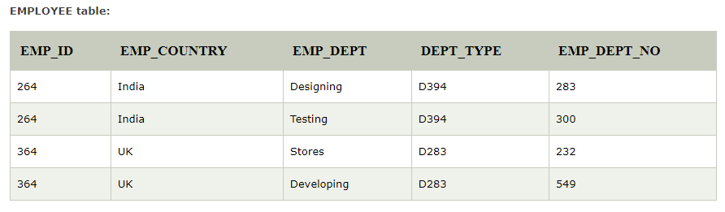

Slide 68
In the above table Functional dependencies are as follows:
EMP_ID → EMP_COUNTRY
EMP_DEPT → {DEPT_TYPE, EMP_DEPT_NO}
Candidate key: {EMP-ID, EMP-DEPT}
The table is not in BCNF because neither EMP_DEPT nor EMP_ID alone are keys.

Slide 69
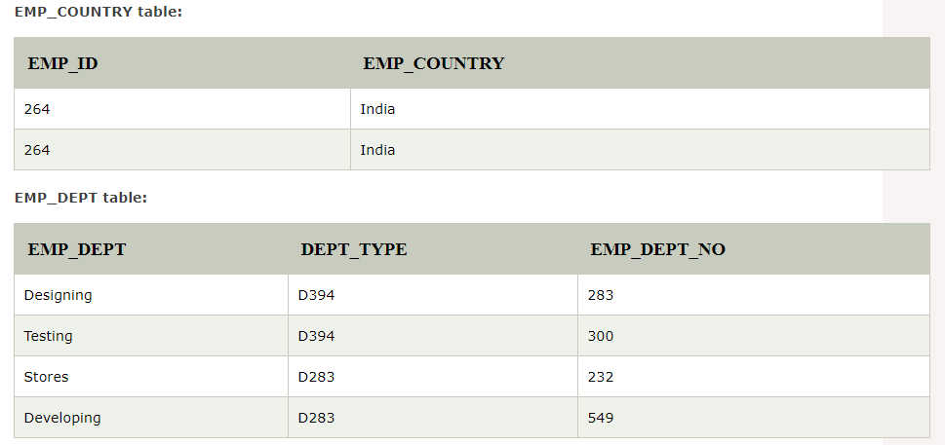
To convert the given table into BCNF, we decompose it into three tables:

Slide 70
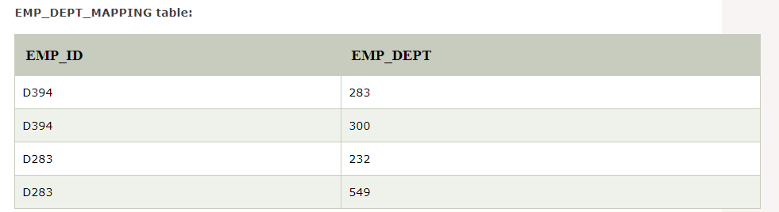

Slide 71
Functional dependencies:
EMP_ID → EMP_COUNTRY
EMP_DEPT → {DEPT_TYPE, EMP_DEPT_NO}
Candidate keys:
For the first table: EMP_ID
For the second table: EMP_DEPT
For the third table: {EMP_ID, EMP_DEPT}
Now, this is in BCNF because left side part of both the functional dependencies is a key.

